Slide 1


Shop Easy
Marketing Analytics Portfolio Project
By:Ahmed Mahmoud

Slide 2

Content
Business Understanding
Sources of Data
Exploratory Data Analysis (EDA)
Visualizing Key Trends a Patterns
conclustions

Slide 3

?
Business
Understanding

Slide 4



Shop Easy's Business
Shop Easy is an online retail platform
Aim: Understand the reasons behind the decline in customer engagement and satisfaction.
Identify weaknesses in the current marketing strategies.
Target audience
Shop Easy’s marketing team and decision-makers.
Key stakeholders responsible for implementing and refining marketing strategies.

Slide 5

?
Problems
Decline in customer satisfaction and engagement.
Drop in engagement and conversion rates despite increased investment in marketing campaigns.

Slide 6

sources of data collection:
Google data set

Slide 7

Key Performance Indicators (KPIs)
Conversion Rate: Percentage of website visitors who make a purchase.
Customer Engagement Rate: Level of interaction with marketing content (clicks, likes, comments).
Customer Feedback Score: Average rating from customer reviews.

Slide 8
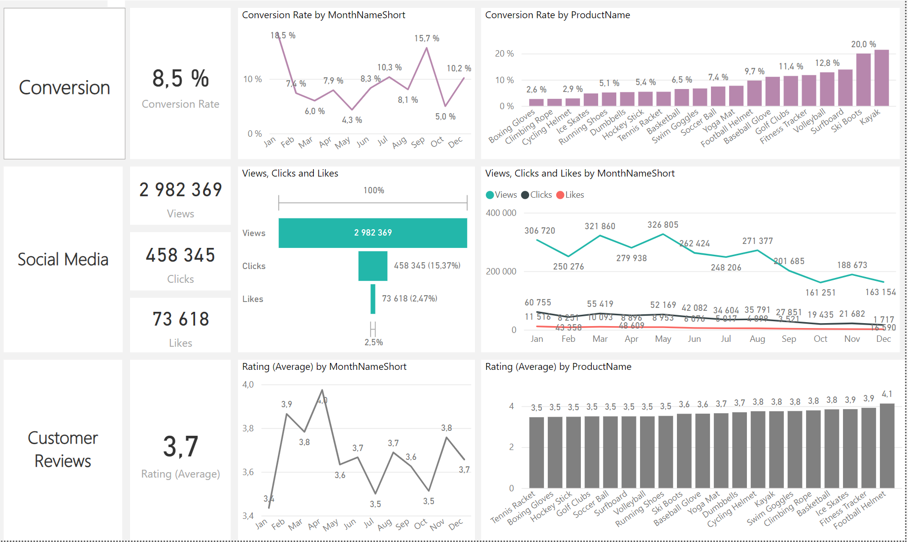
Overview dashboard
Decreased Conversion Rates:
Rebounded to 10.2% in December after dropping to 5.0% in October.
Customer Feedback Analysis:
Average rating remained steady at 3.7, below the target of 4.0, indicating a need for improvements in customer satisfaction, particularly for products rated below 3.5.
Social Media Engagement:
Views declined overall, but the 15.37% click-through rate indicates effective interaction among engaged users.

Slide 9
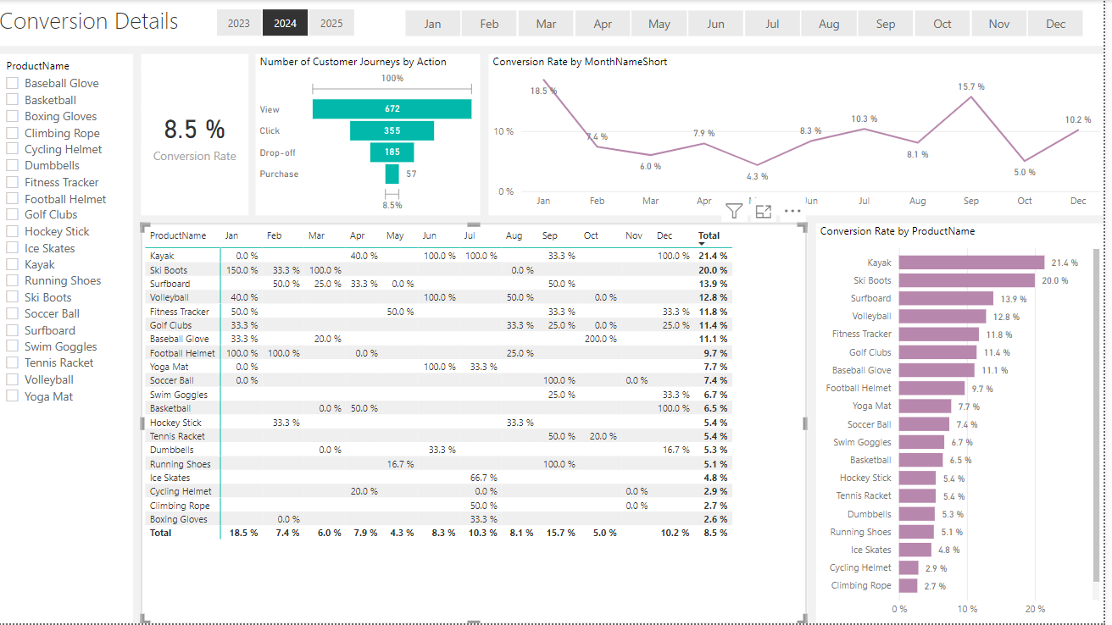
conversion dashboard

Slide 10

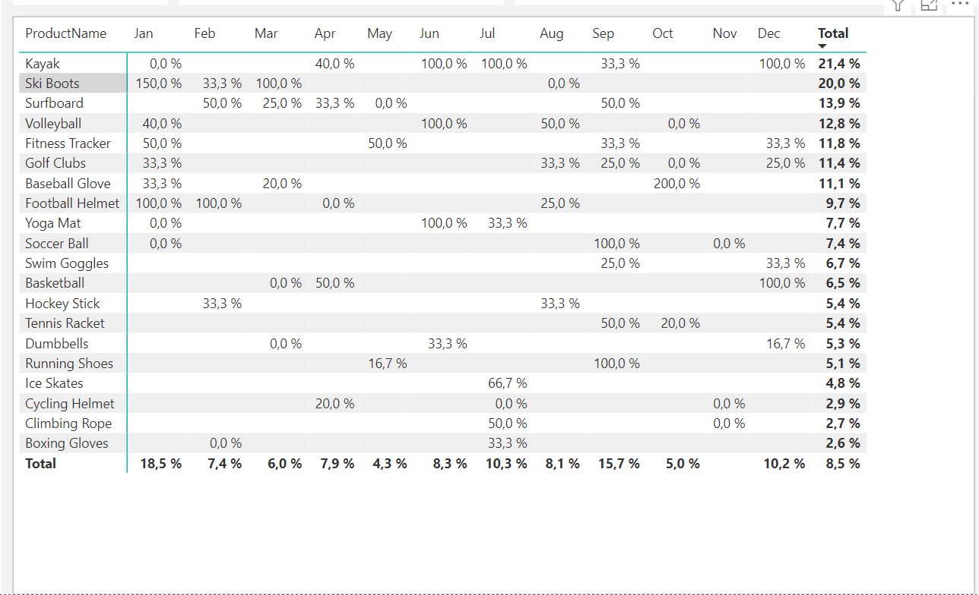
Conversion Trends Summary:
Highest Conversion: January at 18.5%, led by Ski Boots with 150% conversion, driven by seasonal demand.
Lowest Conversion: May at 4.3%, requiring improved marketing strategies.
General Trend: Peaks in February and July highlight seasonal opportunities; lower months need targeted interventions.

Slide 11
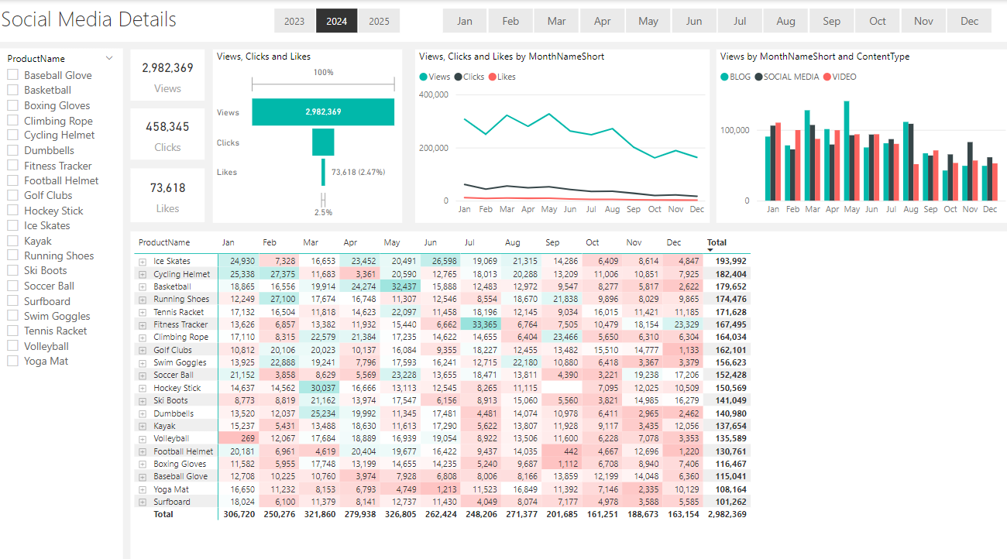
Social media dashboard

Slide 12

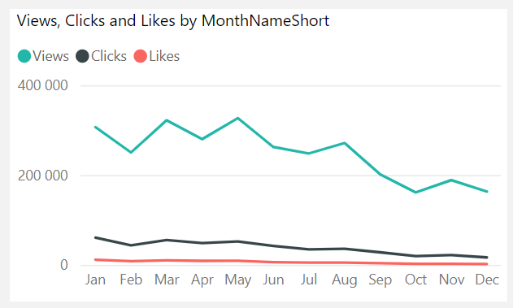
Engagement Trends Summary:
Declining Views: Peaked in May and March but dropped from August onward, showing reduced engagement later in the year.
Low Interaction Rates: Clicks and likes were consistently low relative to views, indicating a need for more engaging content.

Slide 13

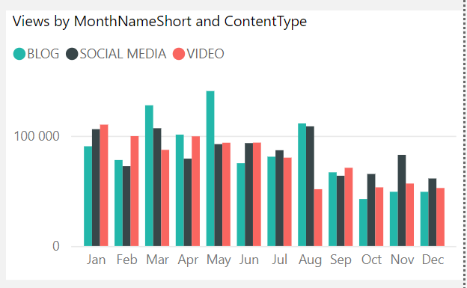
Engagement Trends Summary:
Content Performance: Blogs performed best, especially in April and July, while social media and video content showed steady but lower engagement.

Slide 14
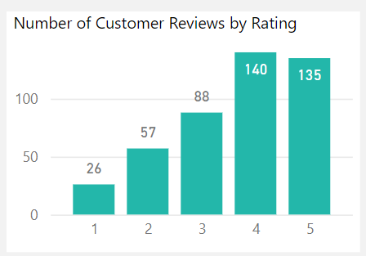
Customer Ratings Summary:
Most customer reviews reflect positive feedback, with 140 reviews at 4 stars and 135 reviews at 5 stars. Lower ratings (1-2 stars) are less common, totaling 83 reviews, indicating that negative experiences are in the minority.

Slide 15
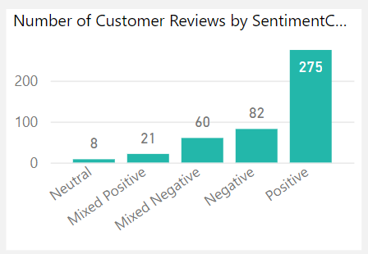
Sentiment Analysis Summary: The sentiment analysis shows that Shop Easy enjoys strong customer satisfaction, with the majority of reviews being positive. However, negative reviews highlight some areas that require improvement. Neutral reviews were minimal, indicating that customers generally have clear opinions about their experiences.

Slide 16
Conclusion:
Shop Easy demonstrates overall strong customer satisfaction, with the majority of reviews being positive and high ratings dominating. However, there are areas for improvement highlighted by lower ratings and negative sentiments. Additionally, the current marketing efforts may not be targeting the right audience effectively, as suggested by declining engagement and conversion rates. By addressing these concerns, optimizing their marketing strategies, and refining their target audience, Shop Easy can enhance customer engagement, improve satisfaction, and drive higher conversion rates.

Slide 17
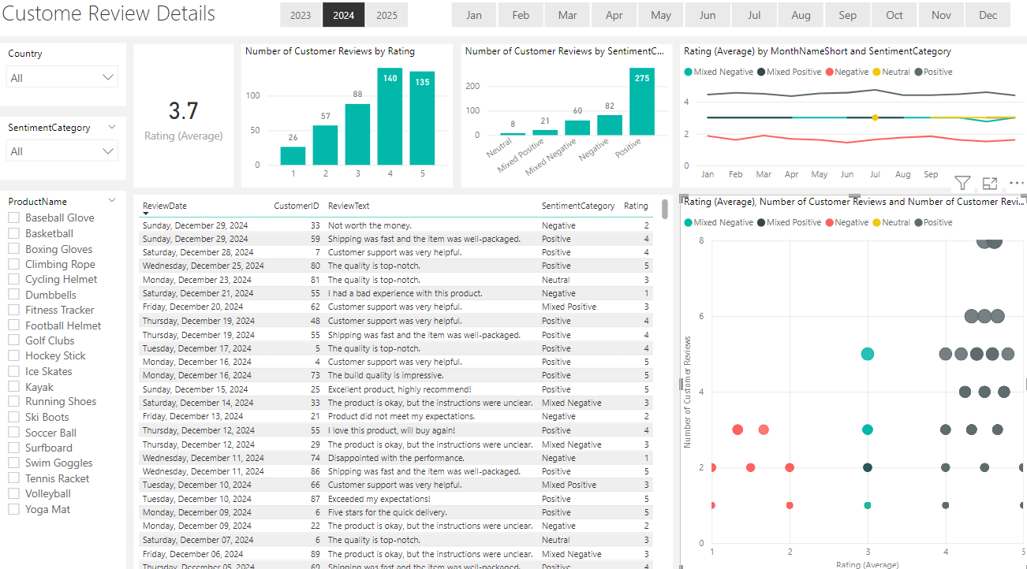
Customer review dashboard

Slide 18
?
Any Questions

